Slide 1
Doctor’s Fee Prediction

Slide 2
Content
Team
Objective
Programs, IDE & Libraries Used
Exploratory Data Analysis
Model Summary
Input Parameters
Challenges Faced

Slide 3
Team
Mohit Verma
Lakkoju Aman
Adarsh Vasireddy
Robin Singh
Chitra Pandey
Rahul Kumar

Slide 4
Objectives:
To scrape the information of doctors from Delhi, Mumbai and Bangalore registered on Practo.
To create a machine learning model that predicts the doctor’s consultation fee.
Deploying the model trained on web.

Slide 5
Programs, IDE & Libraries Used
Python
Beautiful Soup
Selenium
Pandas
Scikit-learn
HTML & CSS
Flask

Slide 6
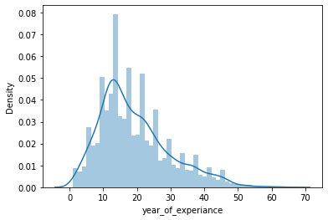
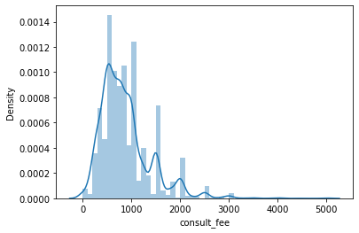
Exploratory Data Analysis

Slide 7
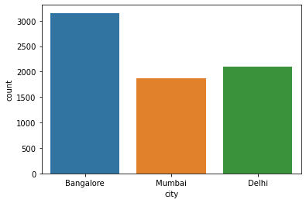
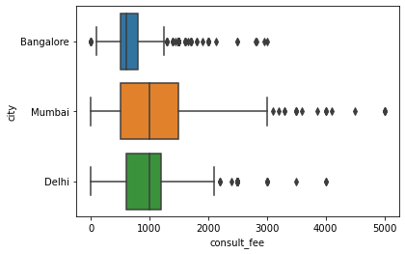
Exploratory Data Analysis

Slide 8
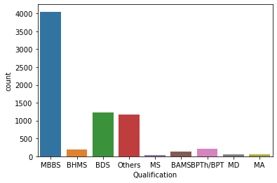
Exploratory Data Analysis

Slide 9
Model Summary
Model | R2 | MSE | RMSE
Linear Regression | 0.42 | 115671.015 | 340.104
Regression Tree | 0.36 | 277134.830 | 526.435
Random Forest Regression | 0.25 | 152185.714 | 390.109
K Nearest Neighbour | 0.21 | 159351.094 | 399.188
Polynomial Regression | 0.32 | 213270.918 | 461.812
Support Vector Regression (‘rbf’) | 0.08 | 185724.425 | 430.957
Support Vector Regression (‘linear’) | 0.19 | 163653.401 | 404.541

Slide 10
Input Parameters
City (DropDown Menu)
Specialization (DropDown Menu)
Qualification (DropDown Menu)
Experience (In Numbers Only)
Rating ( In Percentage Only)
Upvotes (In Numbers Only)

Slide 11
Let’s See Live Demo

Slide 12
Challenges Faced
Scraping Data from Practo
Data Cleaning and Pre Processing
Data is MultiModal
Applying Encoding on Categorical Variables
Deploying the Model

Slide 13
Thank You!

